Slide 1
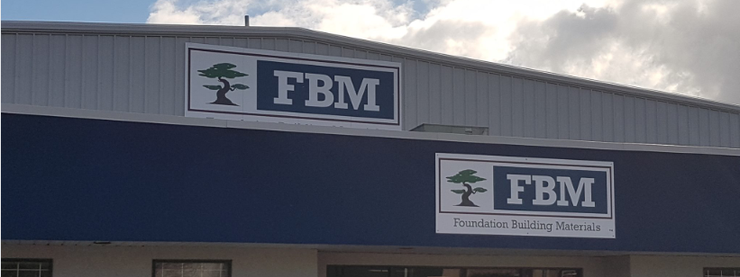

Lowe’s Integration Process automation Case Study
August 2020

Slide 2



Use Case:
FBM receives Invoices from their customers every day.
They have more than 200 vendors and one vendor can send multiple invoices every day.
The FBM Team enters the invoice details in lowe’s website.

Slide 3


AS-IS Process:
User accesses the invoice and extracts details from it.
User enters the extracted details in Lowe’s website.
After entering the details, User confirm the details and submits the invoice.
User repeats the above steps for all the invoices from vendors.

Slide 4


Business Challenge:
The data we handle is associated with finance. Hence, this process is highly sensitive.
The process is done manually by user and has a high possibility for manual error.

Slide 5


Process Flow – High Level
User Navigates to Invoice from scratch page
User enters the invoice details in website.
Start
User logs into Lowe’s website
End
User Submits the invoice and clicks OK in confirmation Pop-up

Slide 6
Process Flow – Low Level
Stop
Start
For each input sheet extract invoice details.
Navigate to Invoice from scratch page and enter the next invoice number details
Login into Lowe’s website and navigate to invoice from scratch page..
Extract total due amount
Enter the details in Lowe’s website.
Click save invoice
Append the details to same invoice
If Invoice Number is different than previous invoice number
While extracting the next invoice details check for invoice number

Slide 7
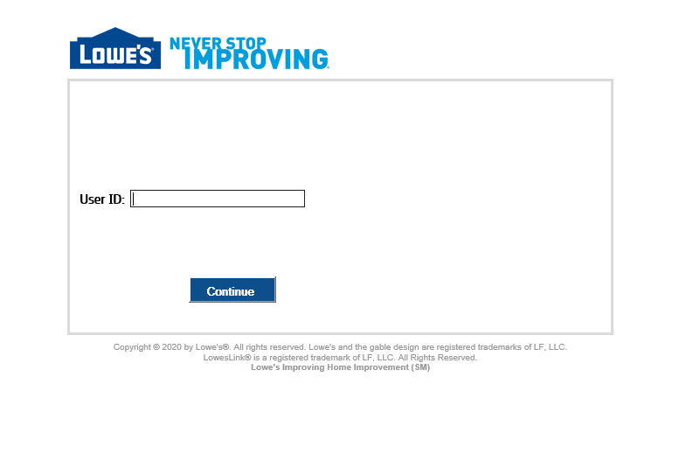
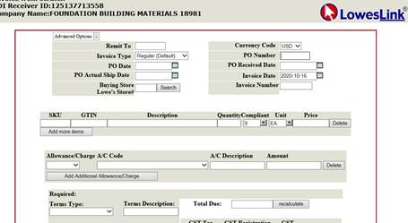
Step by Step Process:
Step 1: User Logs into Lowe’s website.
Step 2: User Navigates to “Invoice from scratch” page.

Slide 8
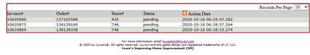
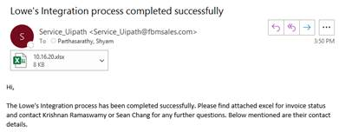
Step by Step Process:
Step 3: User enters the Invoice details in “Invoice from scratch” page
Step 4: User submits the invoice.
Step 5: User clicks “OK” in Confirmation Pop-up and moves to next invoice.

Slide 9

Challenges Faced:
Entering the correct date for an invoice was a big challenge as the date dialog box has previous month dates.
As the order of invoices and SKU’s are changing, it was very difficult to sort that out.
Since it is a production site, We need to test with invoices and delete them repeatedly.

Slide 10
Lessons Learnt:
The requirement gathering should be done properly.
We should take care of aggregate exception while killing the existing processes before starting lowe’s integration process.
The process should be analyzed from all angles to do exception handling.

Slide 11
Benefits:
Time Take with Manual effort:
For 1 invoice= 300 seconds (approximately) = 35 minutes/week
Time taken by Robot:
For 1 invoice = 90 seconds (approximately) = 1.5 minutes/ per week
Time saved per month for 1 invoice approximately = 134 minutes
Currently , the process is run for 1 vendor and the client is extending the same process for 200 vendors. Each vendor will have multiple invoices.
The bot takes very less amount of time for invoice processing which saves a huge amount of time..
The bot reduces human errors and improves quality of work.

Slide 12
Thank You

